Slide 1
ORLANDO, FLORIDA
JUNE 21 - 25
Resty Albeza
Miyuki Kim
Daphne Leon Guerrero
Johertz Marfega

Slide 2
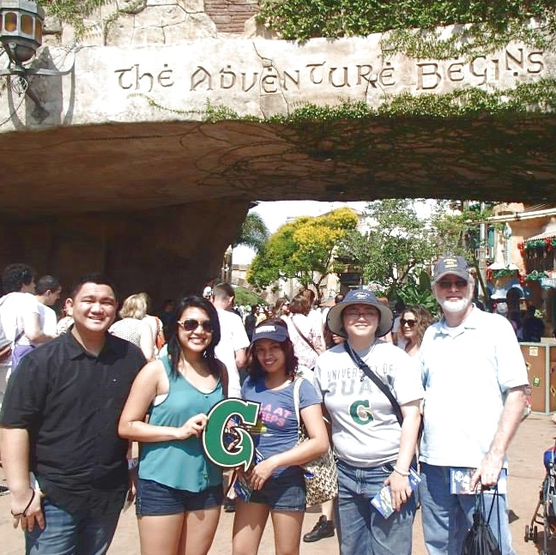

Slide 3
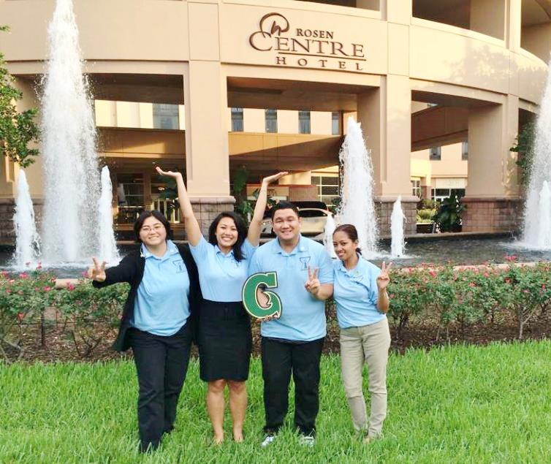
Student Conference
June 21st and 22nd
Rosen Centre Hotel

Slide 4
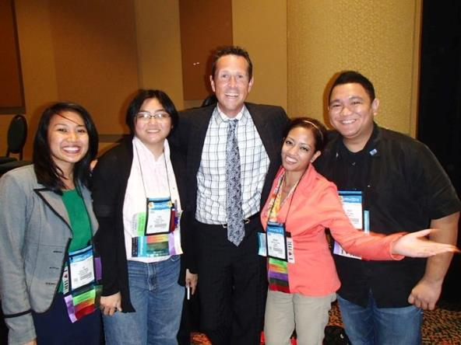
Student Conference
June 21st – Day 1
June 22nd – Day 2
Welcome Keynote
Simon Bailey
Award Presentations
Concurrent Sessions
Now is Your Time
Recruitment Marketing
The Aging Workforce
General Session
Ready, Set, Go!
Networking Reception
General Session
Michael P. Aitken
Closing General Session
Jon Petz

Slide 5
Simon Bailey “Shift Your Brilliance”
See Differently
Harness the Power of You
Ignite a Fresh Vision
Fuel Your Mind
Take the Wheel
Engage Your Gears
Restart Your Engine

Slide 6
Jon Petz “It’s Showtime, and Life Isn’t a Dress Rehearsal”
Give a Showtime Moment
Take Opportunity to Engage
Look at the Bigger Picture
Nobody Remembers Boring
Don’t Limit Yourself

Slide 7
Z Y X W
V U T S R Q P O N
M L K J I H G
F E D C B A

Slide 8
2013 – 2014 Outstanding Student Chapter Award
One of 26 Universities Nationwide
Promotion of the Assurance of Learning Assessment!

Slide 9
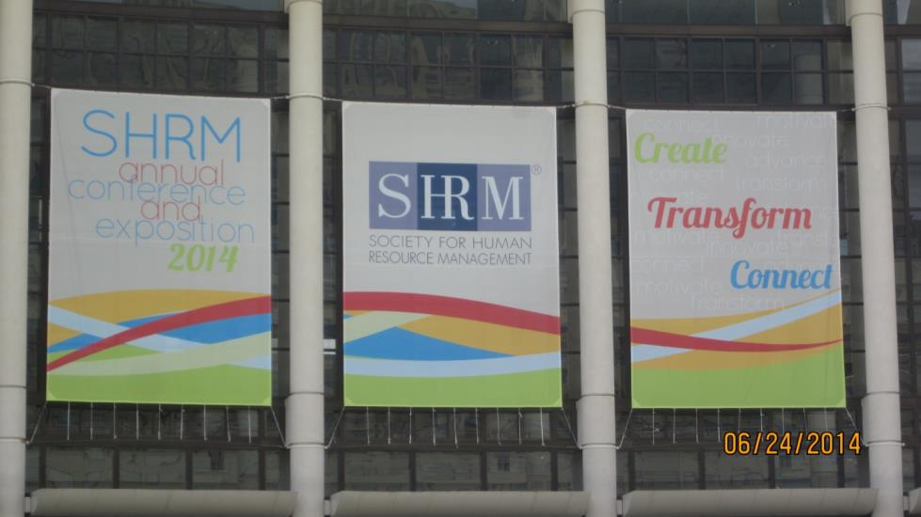
Annual Conference
June 22nd – 25th
Orange County Convention Center - West

Slide 10
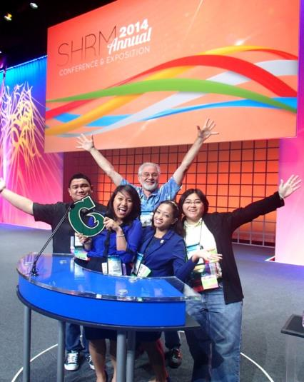
Annual Conference
June 22nd – Day 1
June 23rd – Day 2
Opening General Session
Robin Roberts.
Exhibition Hall Opening
General Session
Tom Friedman
Concurrent Sessions
Anti-Retaliation Provisions
The HR Department of One
Update on Disability Discrimination

Slide 11
Robin Roberts “Good Morning America” News Anchor, Women’s Basketball Hall of Famer
Proximity is Power
Dream Big, Focus Small
Focus on the Fight, not Fright
When You Strut, You Stumble
Make Your Mess Your Message
“People will forget what you said, people will forget what you did, but people will never forget how you made them feel.” – Maya Angelou

Slide 12
Heather Abbot, PHR Boston Marathon Bombing Survivor Life Hacks
Recognize what you can’t change and accept it.
Allow yourself to rely on others.
We must be change agents.

Slide 13
Tom Friedman New York Times Award Winning Journalist Five Ways to Thrive in a Hyper-connected World
Think Like a New Immigrant
Stay hungry
Think Like A Waitress
Think entrepreneurial
Control what you can
Think Like An Artisan
Take pride in your work
Always Be In Beta
You’re a work in progress
PQ + CQ > IQ
“Passion + Curiosity is always greater than Intelligence.”

Slide 14
Annual Conference
June 24th – Day 3
June 25th – Day 4
Closing General Session
Laura Bush
Q&A with Hank Jackson
Concurrent Sessions
Is There Hidden Liability in Your Compensation System?
Please Sue Me
Top 10 Persuasive Communication Strategies
Who Said I-9s Were Boring?
Ethical Alchemy
Build “Better Bosses”
General Session
David Novak
Concurrent Sessions
Effective Public Speaking Strategies
From the Files of the Bizarre
Show Me the Money
Helga’s Back
Detecting Lies and Deception

Slide 15
David Novak President and CEO YUM! Brands (KFC, Taco Bell, etc.)
Recognize Employees in Fun Ways!
Rubber Chicken
Office Wall
1,140 employees

Slide 16
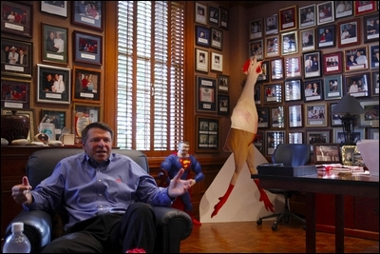

Slide 17
Employment Law & Legislation
The Washington Outlook
Anti-Retaliation Provisions
Update on Disability Discrimination Law
From the Files of the Bizarre
Helga’s Back
Please Sue Me

Slide 18
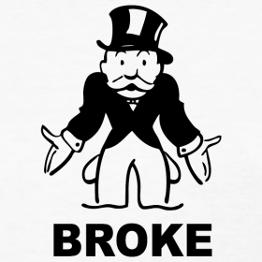
Anti-Retaliation Provisions
Rising Claims
41% - US
53% - Guam
Median Costs
$150,000
$75,000
# 1 Rule of Thumb
Be Consistent!

Slide 19
TRIVIA TIME!
From the Files of the Bizarre: The Latest, Most Unusual Employment Law Cases

Slide 20
Schwirse v. OWCP
Gary Schwirse
Longshoreman
Fell 6’, Concrete Ledge
Sued for Worker’s Comp

Slide 21
EEOC v. Walgreens Co.
Josephina Hernandez
Cashier
Bag of Chips
Anti-Grazing Policy
Fired
EEOC - Discrimination

Slide 22
Davis v. Unified School District
Charles Davis
Custodian
Denied 7 Times
Head Custodian
EEOC
Race Discrimination
Retaliation

Slide 23
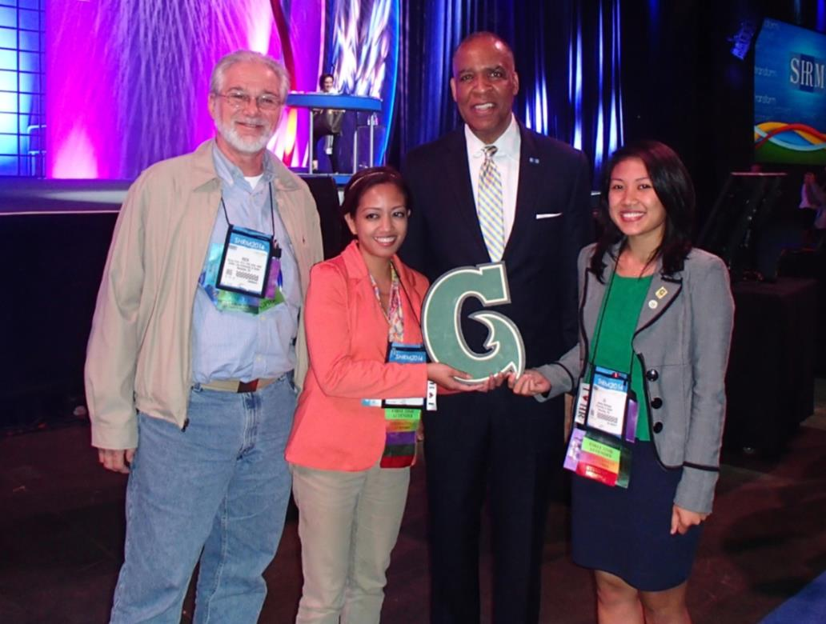
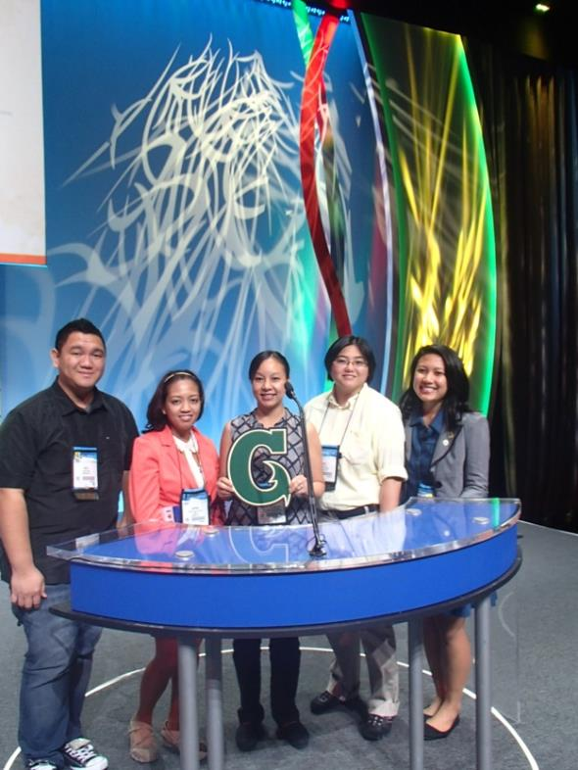
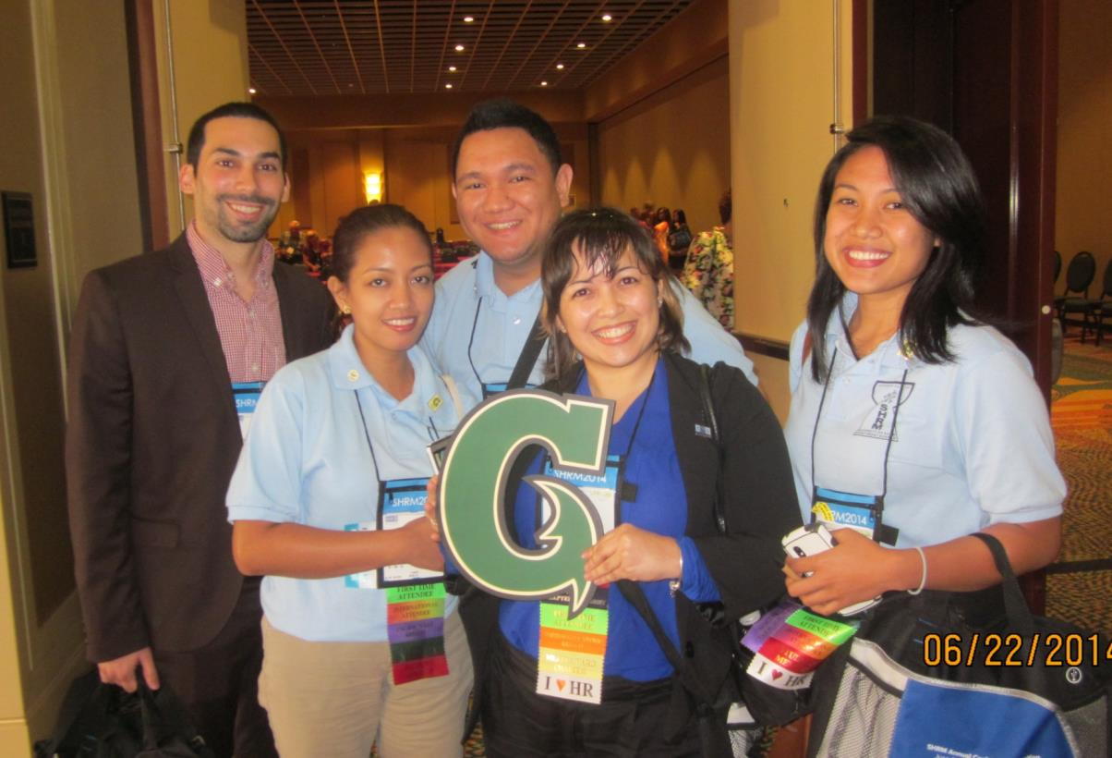
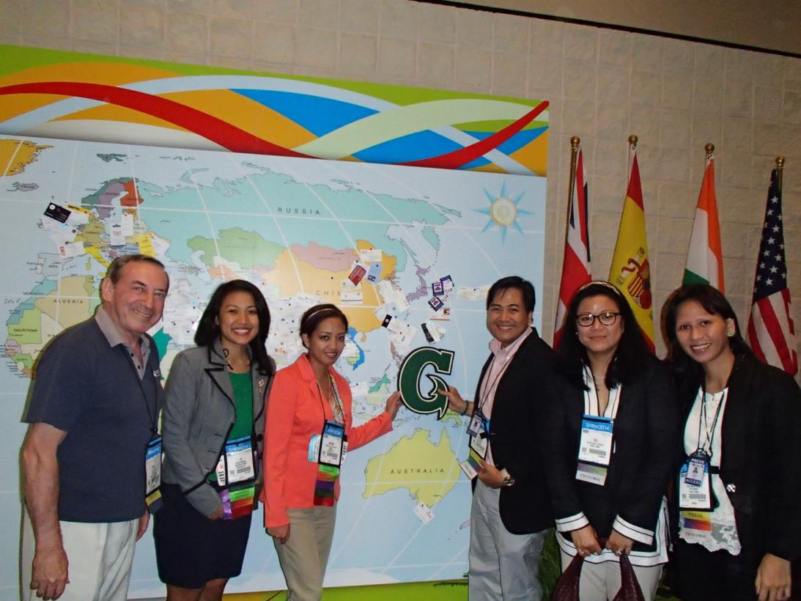
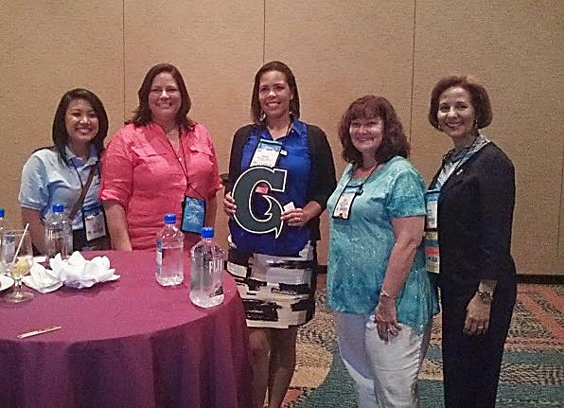
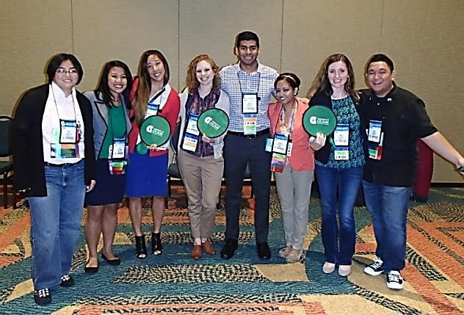
Networking

Slide 24
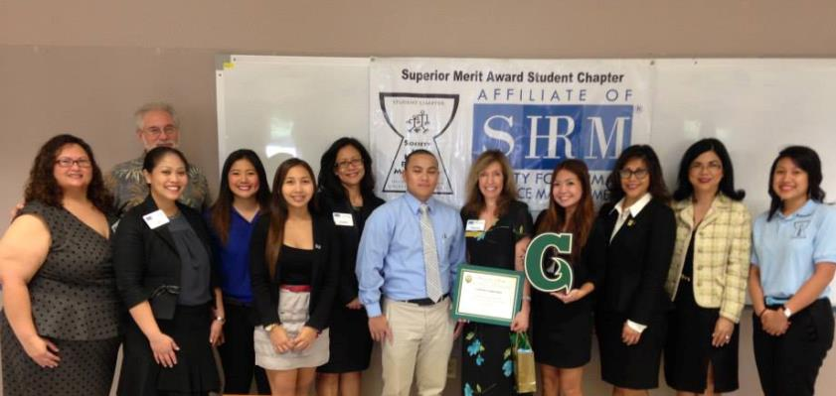
We Appreciate You!

Slide 25
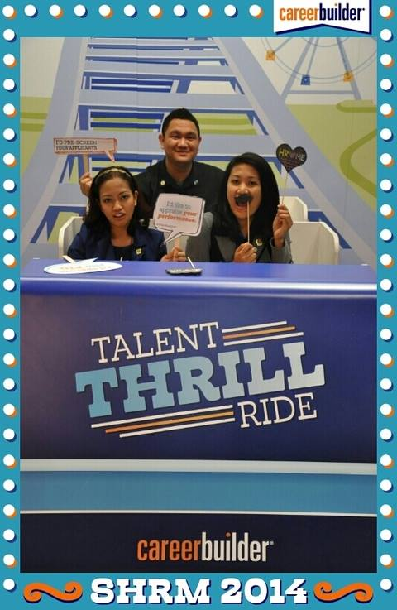
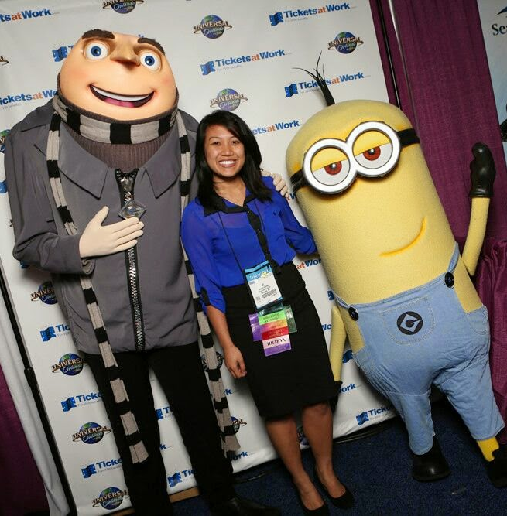
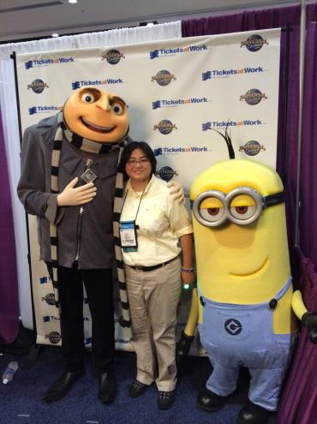
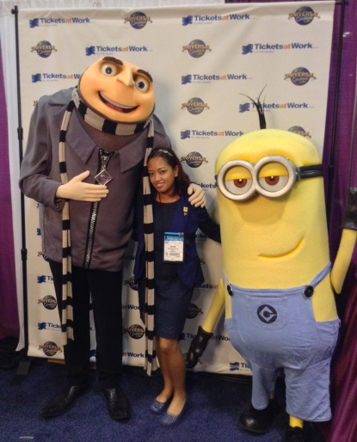
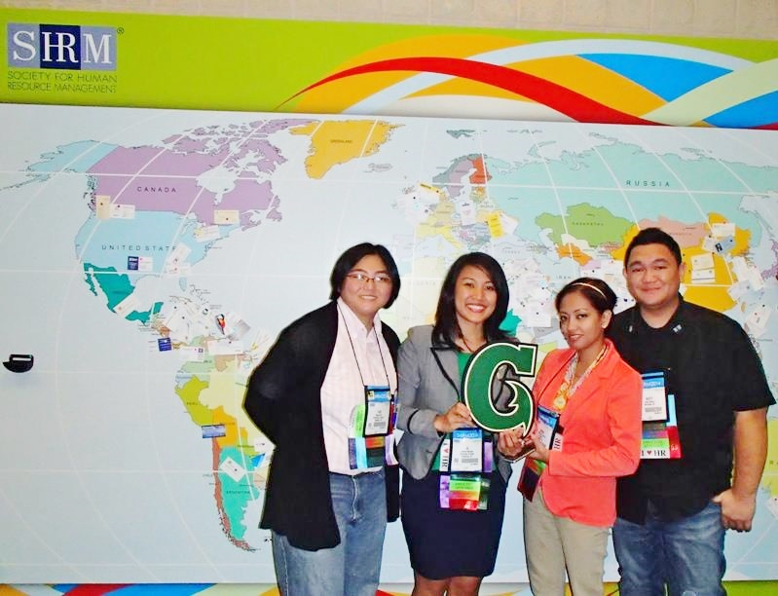
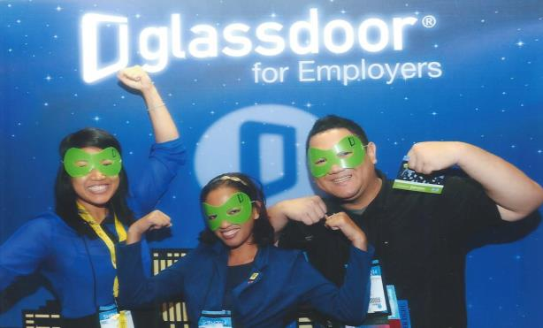
Thank You!

